Slide 1

Diabetes Data Exploration

Slide 2

Questions I am trying to answer:
Principal Component Analysis (PCA):
How many variables we can reduce to, by using Principal Component Analysis?
Are we able to identify the contribution of different features towards the overall variability or explained variance in the diabetes dataset?
Clustering Analysis
Does clustering analysis help in identifying any pattern in the dataset, such as difference in glucose level, age, or insulin?

Slide 3
Questions I am trying to answer:
Exploratory Factor Analysis
Can we reduce the number of factors using EFA, by identifying the minimum number of factors that capture the majority of the variance of the dataset?
Multiple Regression
We are trying to predict the age of the person by using Multiple Regression, based on the other features like pregnancies, glucose, insulin, etc.
Logistic Regression
We are trying to predict the person’s outcome (diabetic or non-diabetic) by using Logistic Regression, based on other features like glucose, insulin, age, etc.

Slide 4
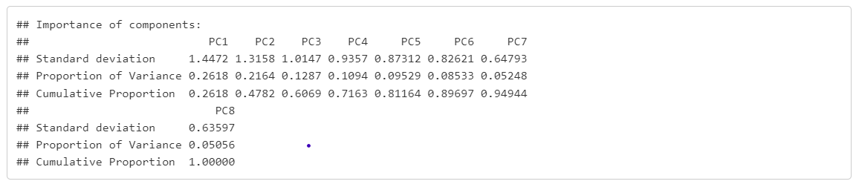
Principal Component Analysis (PCA)
The first 3 components explains almost 61% of the variance.

Slide 5
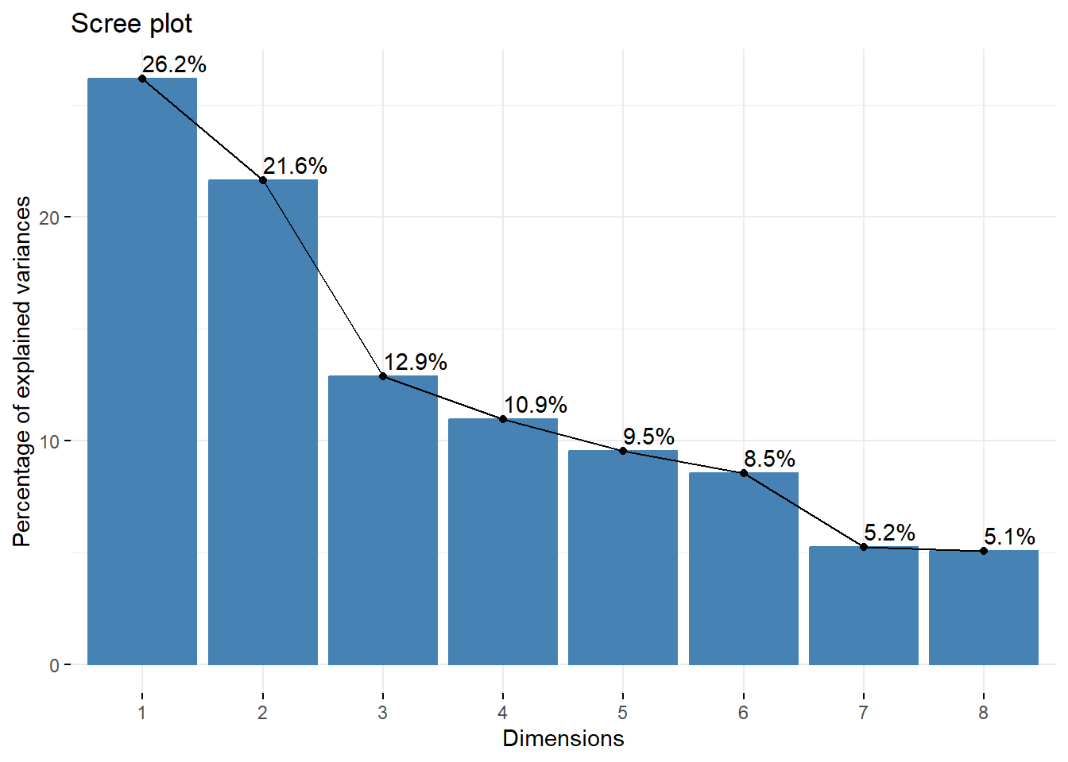
Principal Component Analysis (PCA)
The first 3 components constitutes around 26.2%, 21.6%, and 12.9% respectively.

Slide 6
Principal Component Analysis (PCA)
Based on our Principal Component Analysis (PCA) results, we can explain almost 61% of the variance from the first 3 principal components. This was concluded by scree plot (from elbow on the graph), and also with T-tests, F-tests, and various other plots. We found out that how much variance is being explained by each of the components and the first 3 components have been selected based on it.

Slide 7
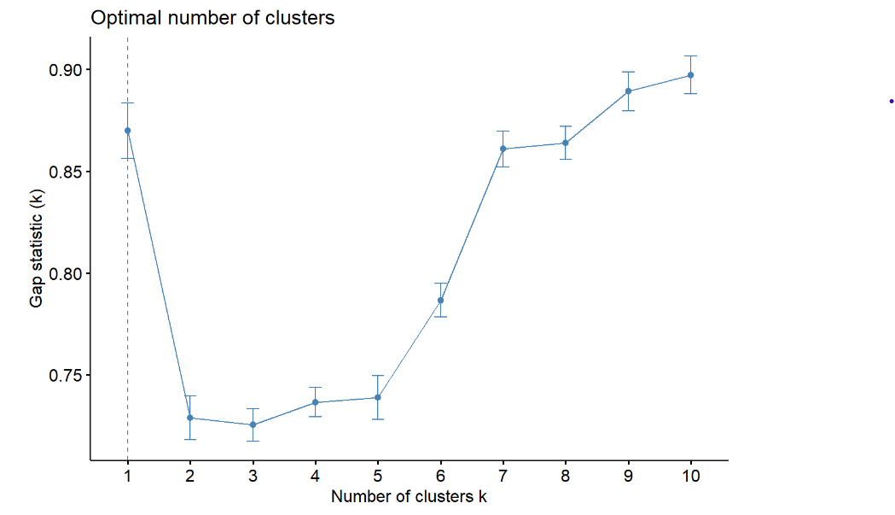
Clustering Analysis
From the graph we can see that, if number of clusters is 1, it has the gap statistics greater than 0.85.
But for 2,3,4, and 5, the gap statistics is almost below 0.75.
We basically prefer the number of clusters that has higher gap statistics because it indicates a better clustering structure.

Slide 8
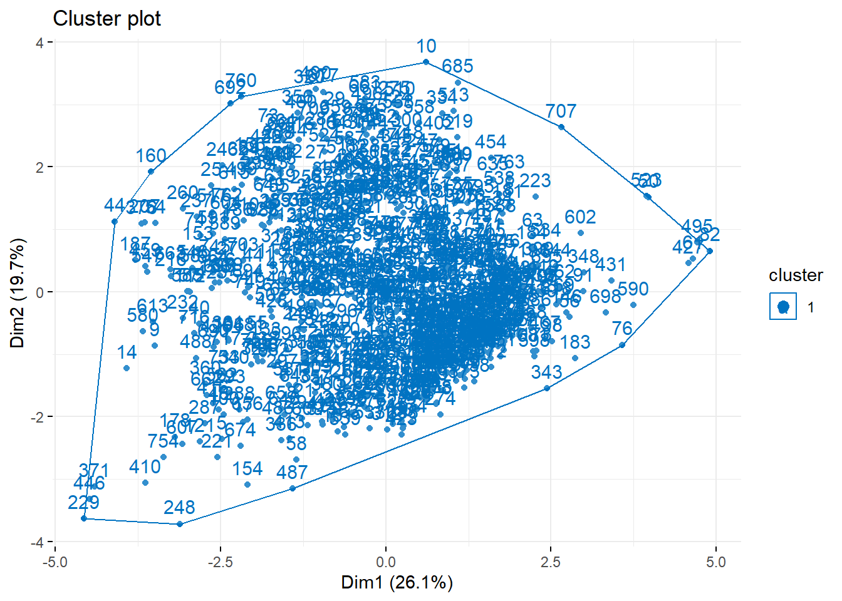
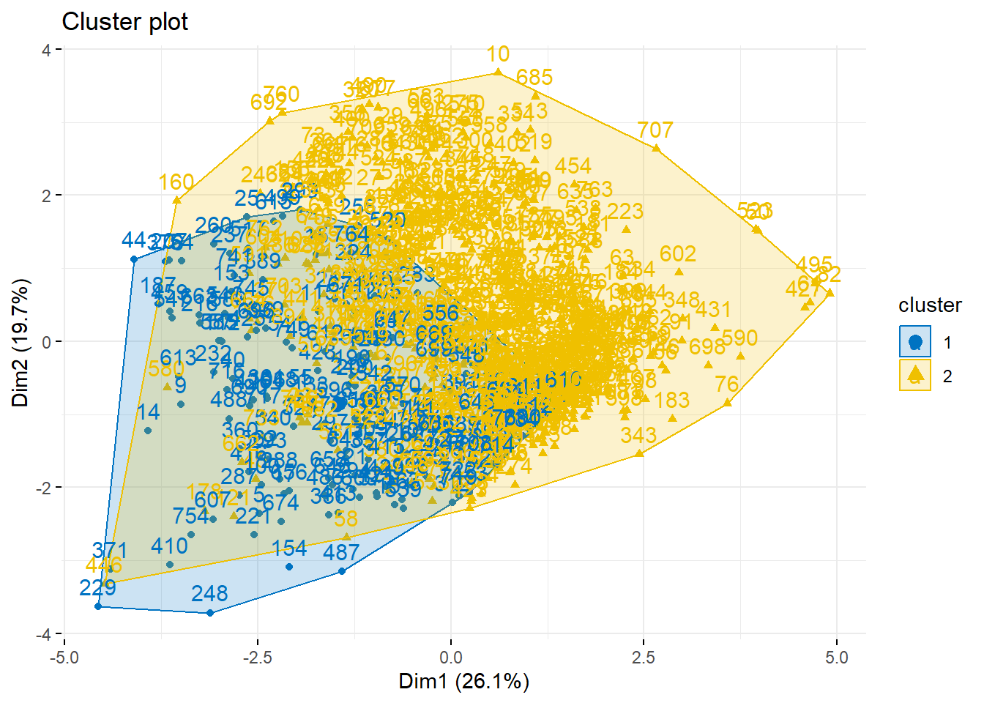
Clustering Analysis
1 Cluster
2 Cluster

Slide 9
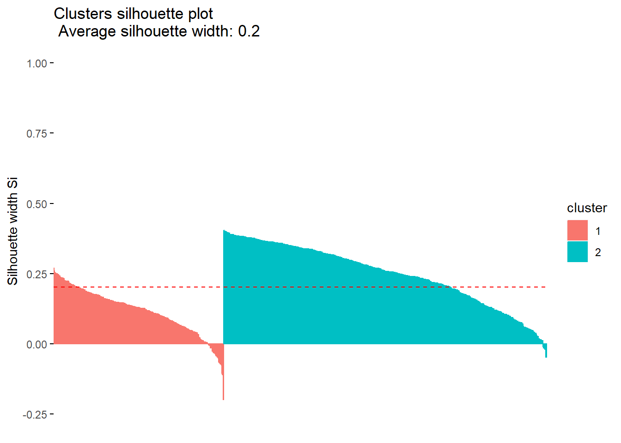
Clustering Analysis
Based on our Clustering Analysis result, we were not exactly able to distinguish between the two group of people, that is diabetic and non-diabetic, because the clusters were getting overlapped. We also tried to measure the quality of clusters using Silhouette value, and the results are attached in the R files/Knitted file. Overall, we found out that glucose and insulin were quite correlated with the person being diabetic. We also found that the optimal number of clusters for our dataset would be 2.

Slide 10
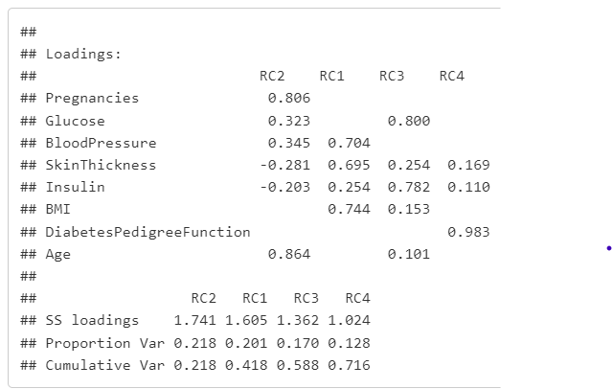
Exploratory Factor Analysis
From the result we can make following conclusions:
RC1 shows the relation with Blood Pressure, Skin Thickness, and BMI.
RC2 shows the relation with Pregnancies, and Age.
RC3 shows the relation with Glucose, and Insulin.
RC4 shows the relation with only Diabetes Pedigree Function.
All four RCs explains around 72% (71.6% precise) of the variance.

Slide 11
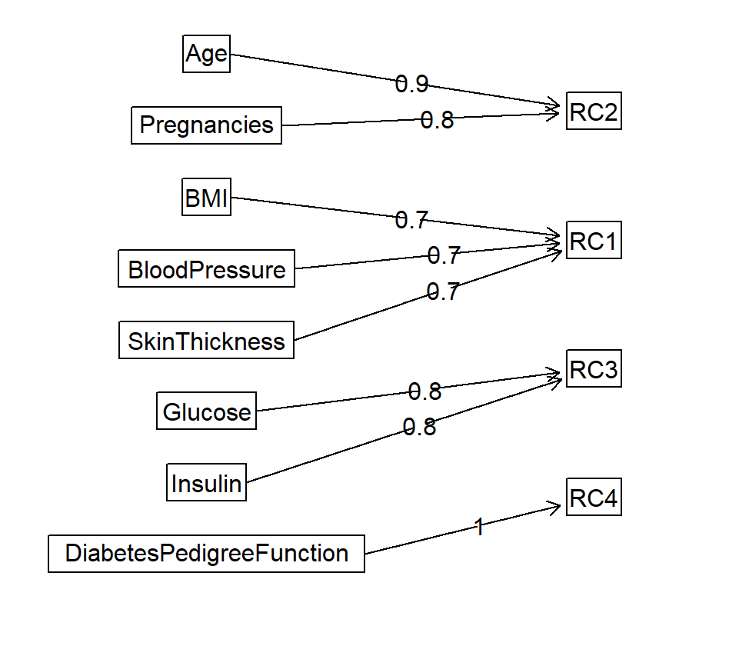
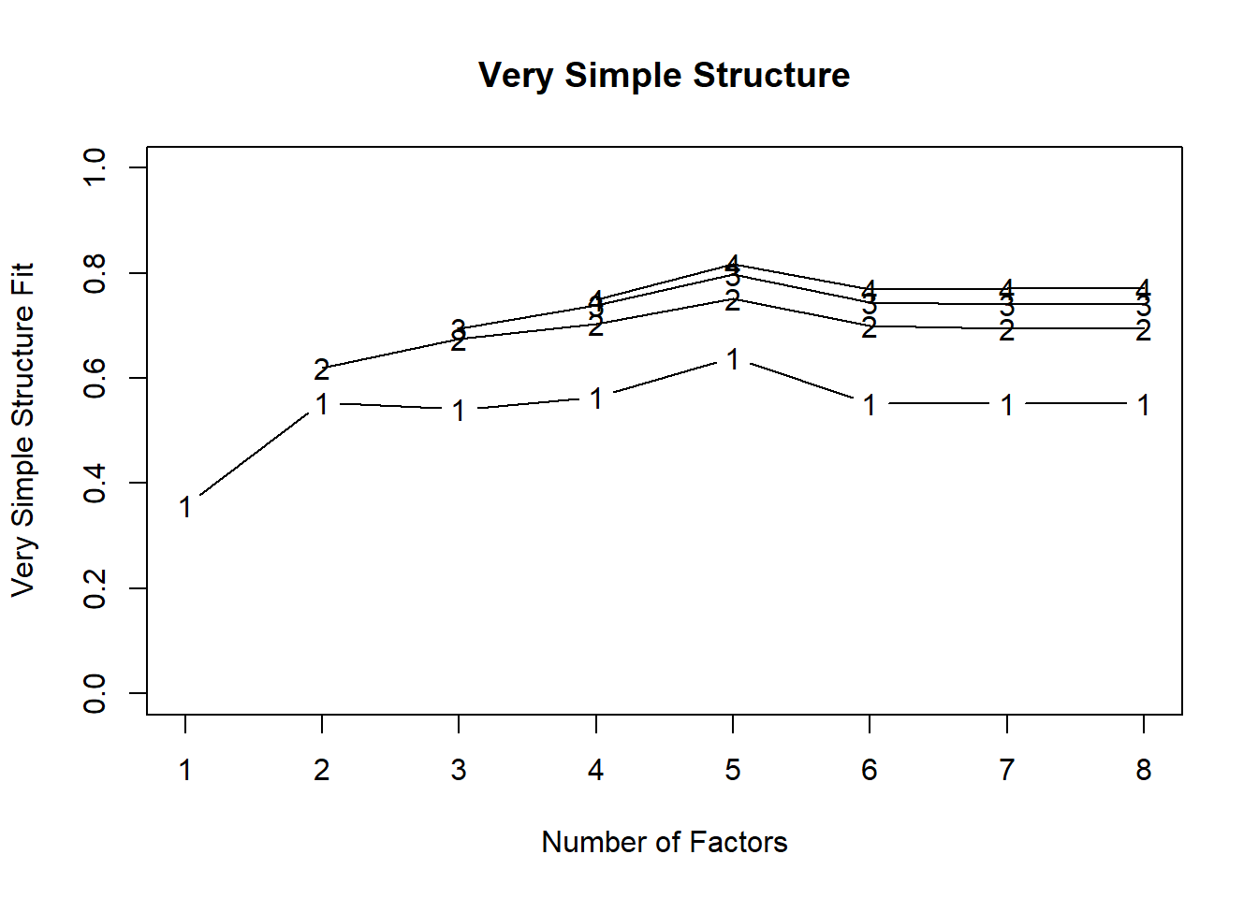
Exploratory Factor Analysis
Component Analysis
Very Simple Structure

Slide 12
Exploratory Factor Analysis
From our Exploratory Factor Analysis (EFA) result, we concluded that the number of factors we can reduce to is 4. The evidence has been provided by using Parallel Analysis Plot, and Very Simple Structure (VSS) Plot. We were able to explain around 72% (approx.) of the variance from our 4 generated factors. Therefore, we reduced the number of features from 8 to 4.

Slide 13
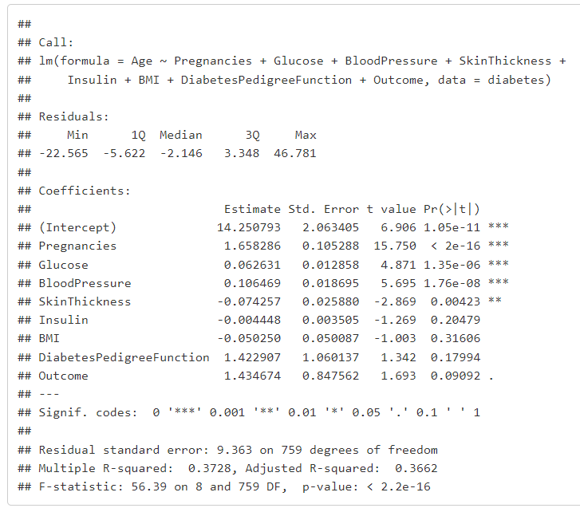
Multiple Regression
The estimated coefficient for "Pregnancies" is 1.66541, which means that for every one-unit increase in the number of pregnancies, the predicted age increases by approximately 1.67 units.
The multiple R-squared is 0.3695, which means that the model explains about 37% of the variability in the age of individuals.
P-value (p-value: < 2.2e-16) suggests that the model is statistically significant, indicating that at least one of the predictor variables has a significant effect on the predicted age.
The estimated residual standard error is 9.369, which indicates the average difference between the observed and predicted age values is approximately 9.37 units.

Slide 14
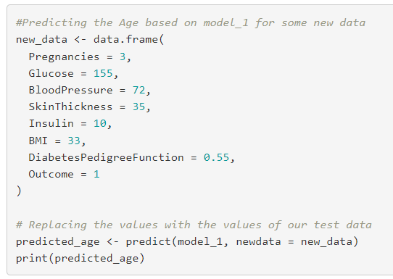
Multiple Regression
By passing some random values (test data) on our model, the model predicted the age to be 34.5 years.

Slide 15
Multiple Regression
From our Multiple Regression result, we made a model that was able to predict the age of the person based on other features like pregnancies, glucose, blood pressure, skin thickness, insulin, BMI, Diabetes Pedigree Function, and Outcome. The interpretation of the results is attached along the codes in the R file/Knitted file. We also predicted a person’s age by passing new random data, and model was able to predict the age

Slide 16
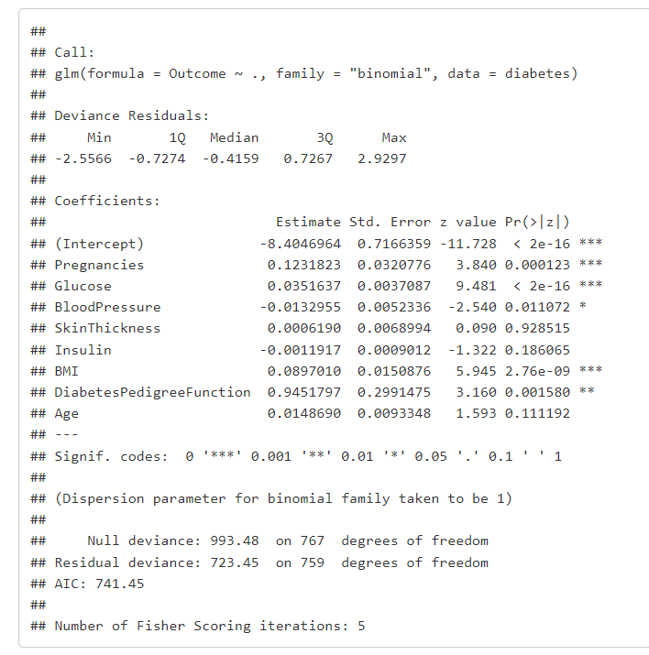
Logistic Regression
The intercept is the log(odds) a person will be diabetic.
Each one-unit change in the glucose level will increase the log odds of getting diabetes by 0.0351.
Getting Blood Pressure and Insulin change by one unit will decrease the log odds of getting diabetes by -0.0132 and -0.00119 respectively.

Slide 17
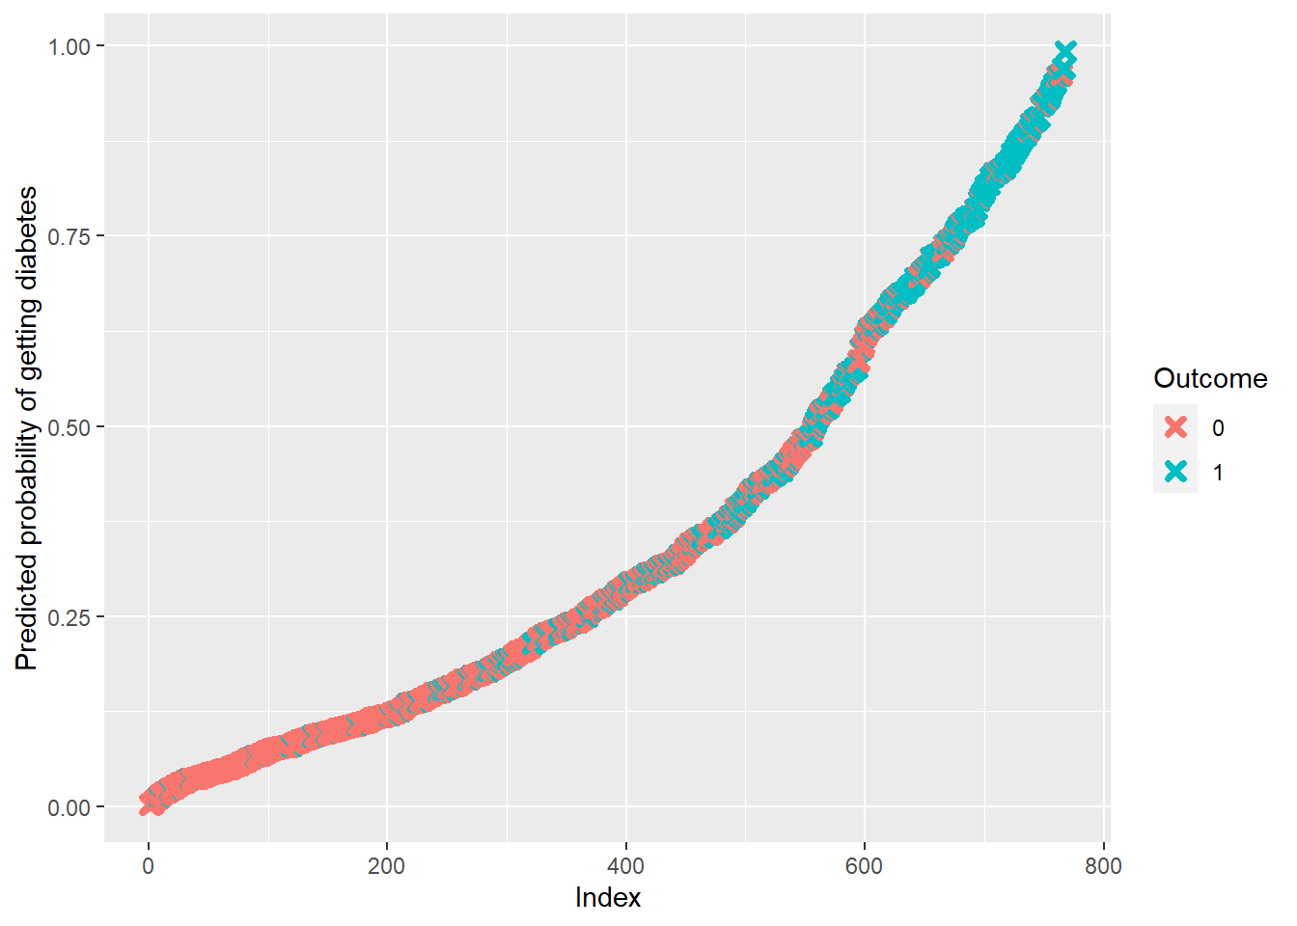
Logistic Regression
We know that as probability of diabetes increases, a person has greater chance of having a diabetes and it is showed with blue color.
Similarly, a person having less probability of diabetes, has less chance of having it.
In our case, 0.50 (approximately from the graph), can be identified as the cut-off or threshold of having a diabetes and not having diabetes.

Slide 18
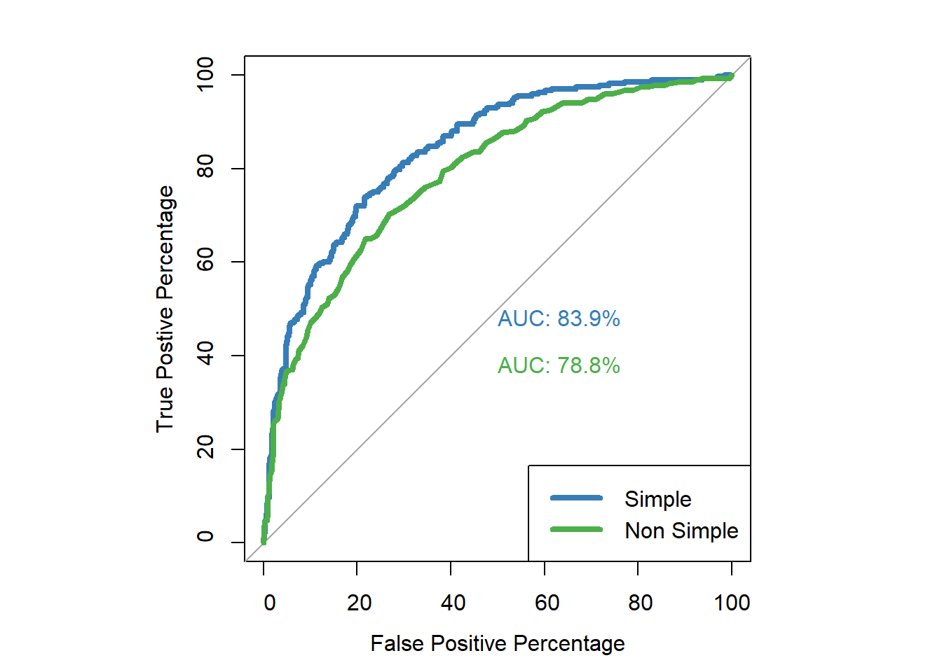
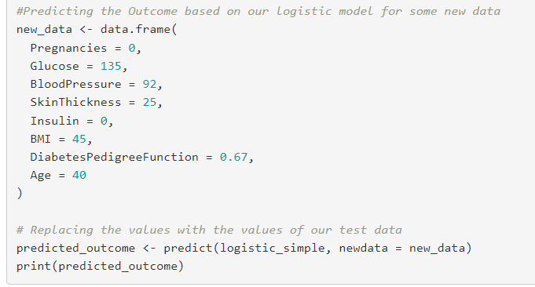
Logistic Regression
By passing some random values (test data) on our model, the model predicted the outcome probability to be 0.399.

Slide 19

Logistic Regression
From our Logistic Regression result, we were able to predict the person’s outcome, whether he/she is diabetic or not by using other features from the dataset. We got an accuracy of 78.26%, that means the model correctly predicted 0.7826 of the instances correctly. We also plotted the AUC curve to evident our results and predicted the outcome of a new random data of the person

Slide 20
THANK YOU
ANY QUESTIONS?
Presentation by: Prince Kheni

